Slide 1
Yield Surface Fitting of Raw DP980 specimens
Thein Lin Aung, Kohki Enomoto, Ninshu Ma
JWRI, Osaka University
2023/03/08

Slide 2
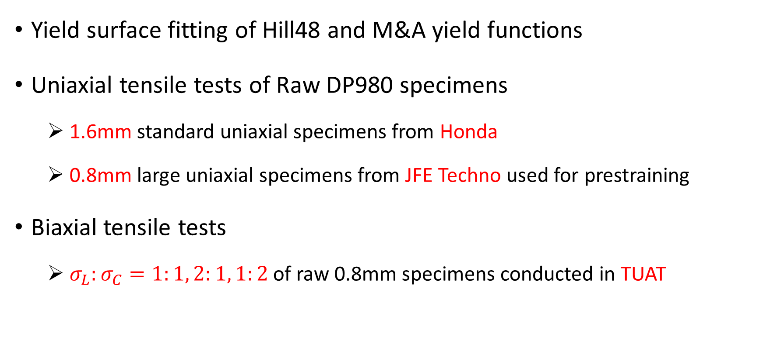
Overview
Yield surface fitting of Hill48 and M&A yield functions
Uniaxial tensile tests of Raw DP980 specimens
1.6mm standard uniaxial specimens from Honda
0.8mm large uniaxial specimens from JFE Techno used for prestraining
Biaxial tensile tests
$σ_{L}:σ_{C}=1:1, 2:1, 1:2$ of raw 0.8mm specimens conducted in TUAT

Slide 3
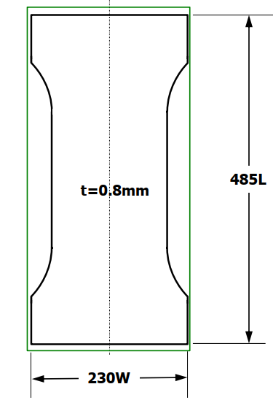
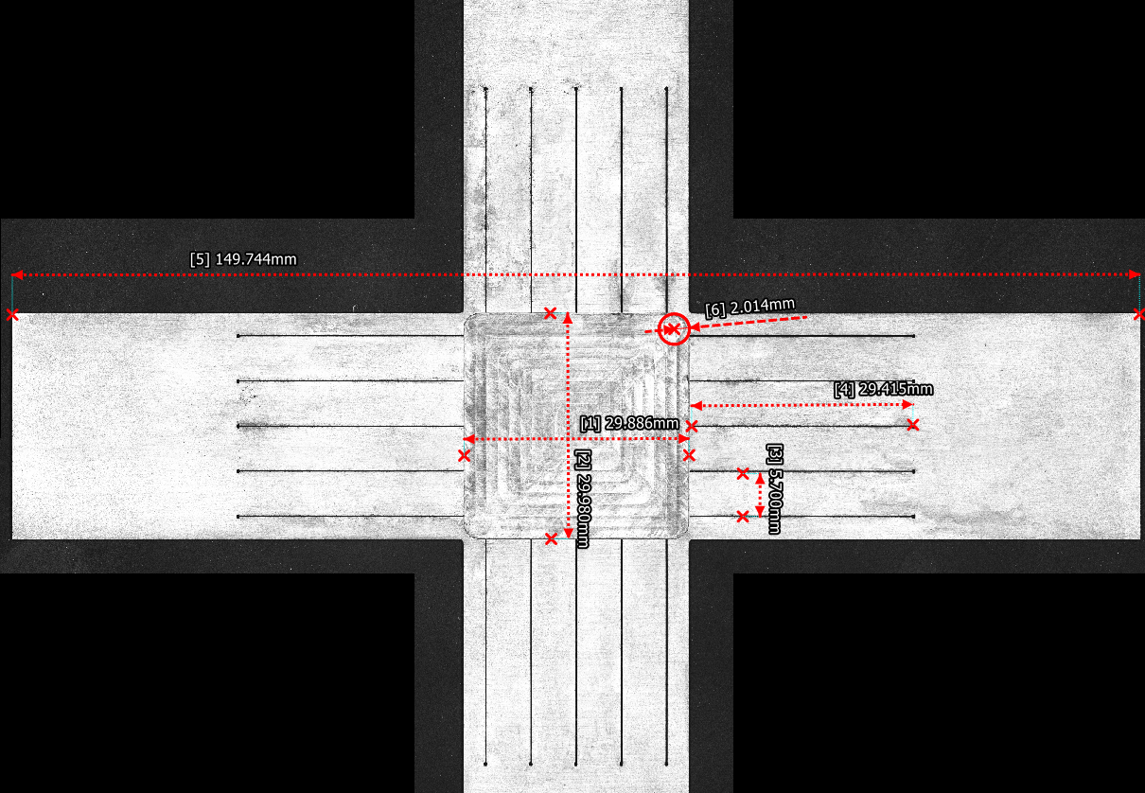
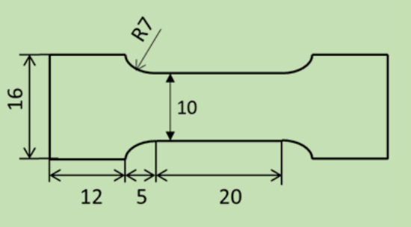
Uniaxial and Biaxial specimens
150 mm
~0.8mm
~0.4mm
30 mm
Standard uniaxial test piece
Honda
(Oct 29, 2021)
Large uniaxial test piece
JFE Techno
(Dec 8, 2022)
Biaxial test piece
TUAT
(Dec 8, 2022)

Slide 4
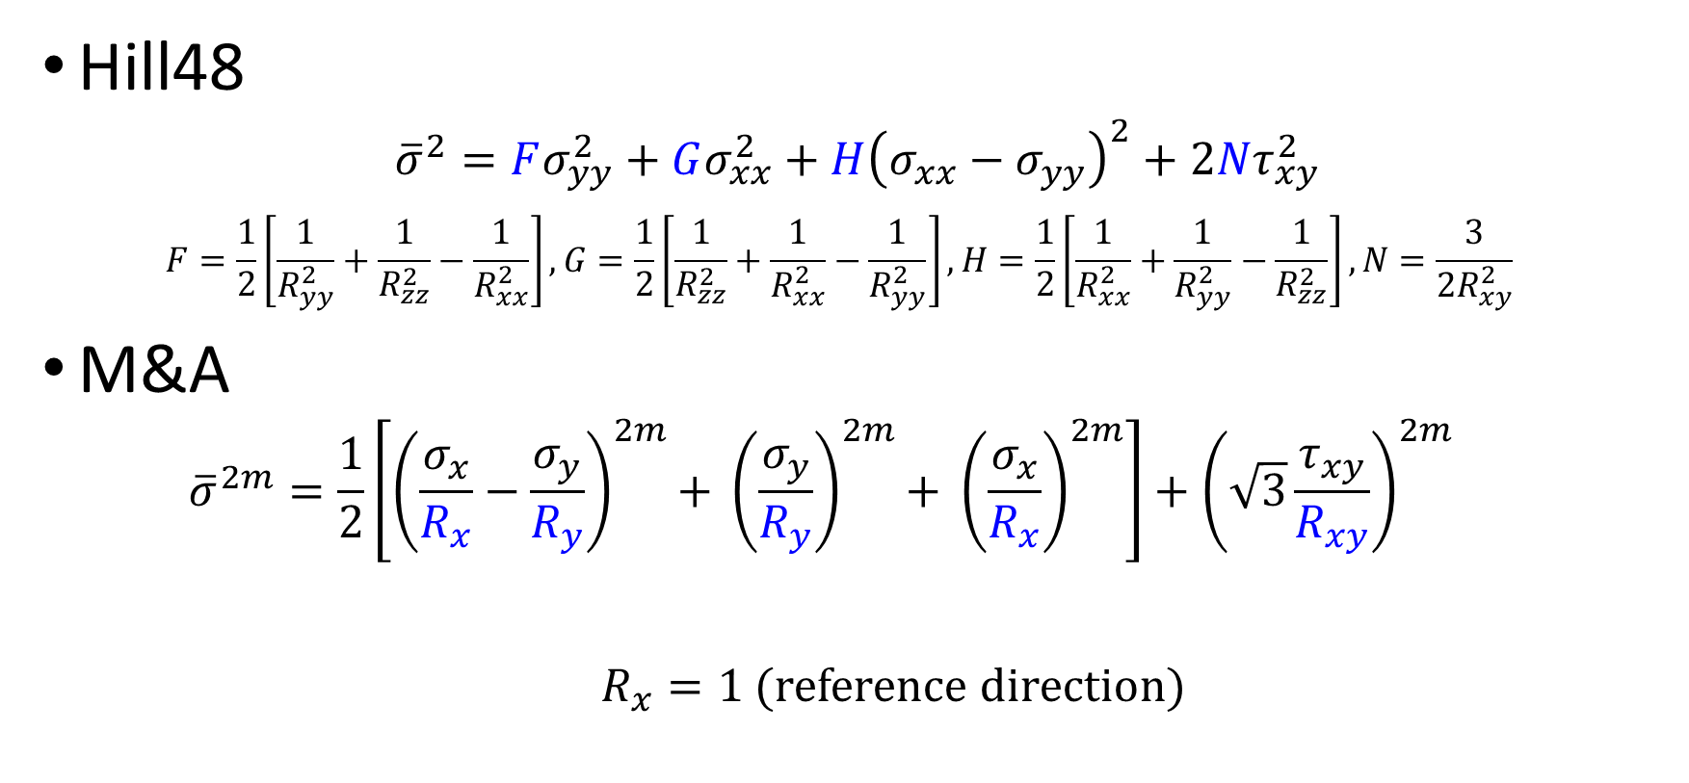
Yield Functions
Hill48
$${\overline{σ}}^{2}=Fσ_{yy}^{2}+Gσ_{xx}^{2}+H{\left(σ_{xx}−σ_{yy}\right)}^{2}+2Nτ_{xy}^{2}$$
$$F=\frac{1}{2}\left[\frac{1}{R_{yy}^{2}}+\frac{1}{R_{zz}^{2}}−\frac{1}{R_{xx}^{2}}\right], G=\frac{1}{2}\left[\frac{1}{R_{zz}^{2}}+\frac{1}{R_{xx}^{2}}−\frac{1}{R_{yy}^{2}}\right], H=\frac{1}{2}\left[\frac{1}{R_{xx}^{2}}+\frac{1}{R_{yy}^{2}}−\frac{1}{R_{zz}^{2}}\right], N=\frac{3}{2R_{xy}^{2}}$$
M&A
$${\overline{σ}}^{2m}=\frac{1}{2}\left[{\left(\frac{σ_{x}}{R_{x}}−\frac{σ_{y}}{R_{y}}\right)}^{2m}\text{+ }{\left(\frac{σ_{y}}{R_{y}}\right)}^{2m}\text{+ }{\left(\frac{σ_{x}}{R_{x}}\right)}^{2m}\right]+{\left(\sqrt{3}\frac{τ_{xy}}{R_{xy}}\right)}^{2m}$$
$R_{x}=1$ (reference direction)

Slide 5
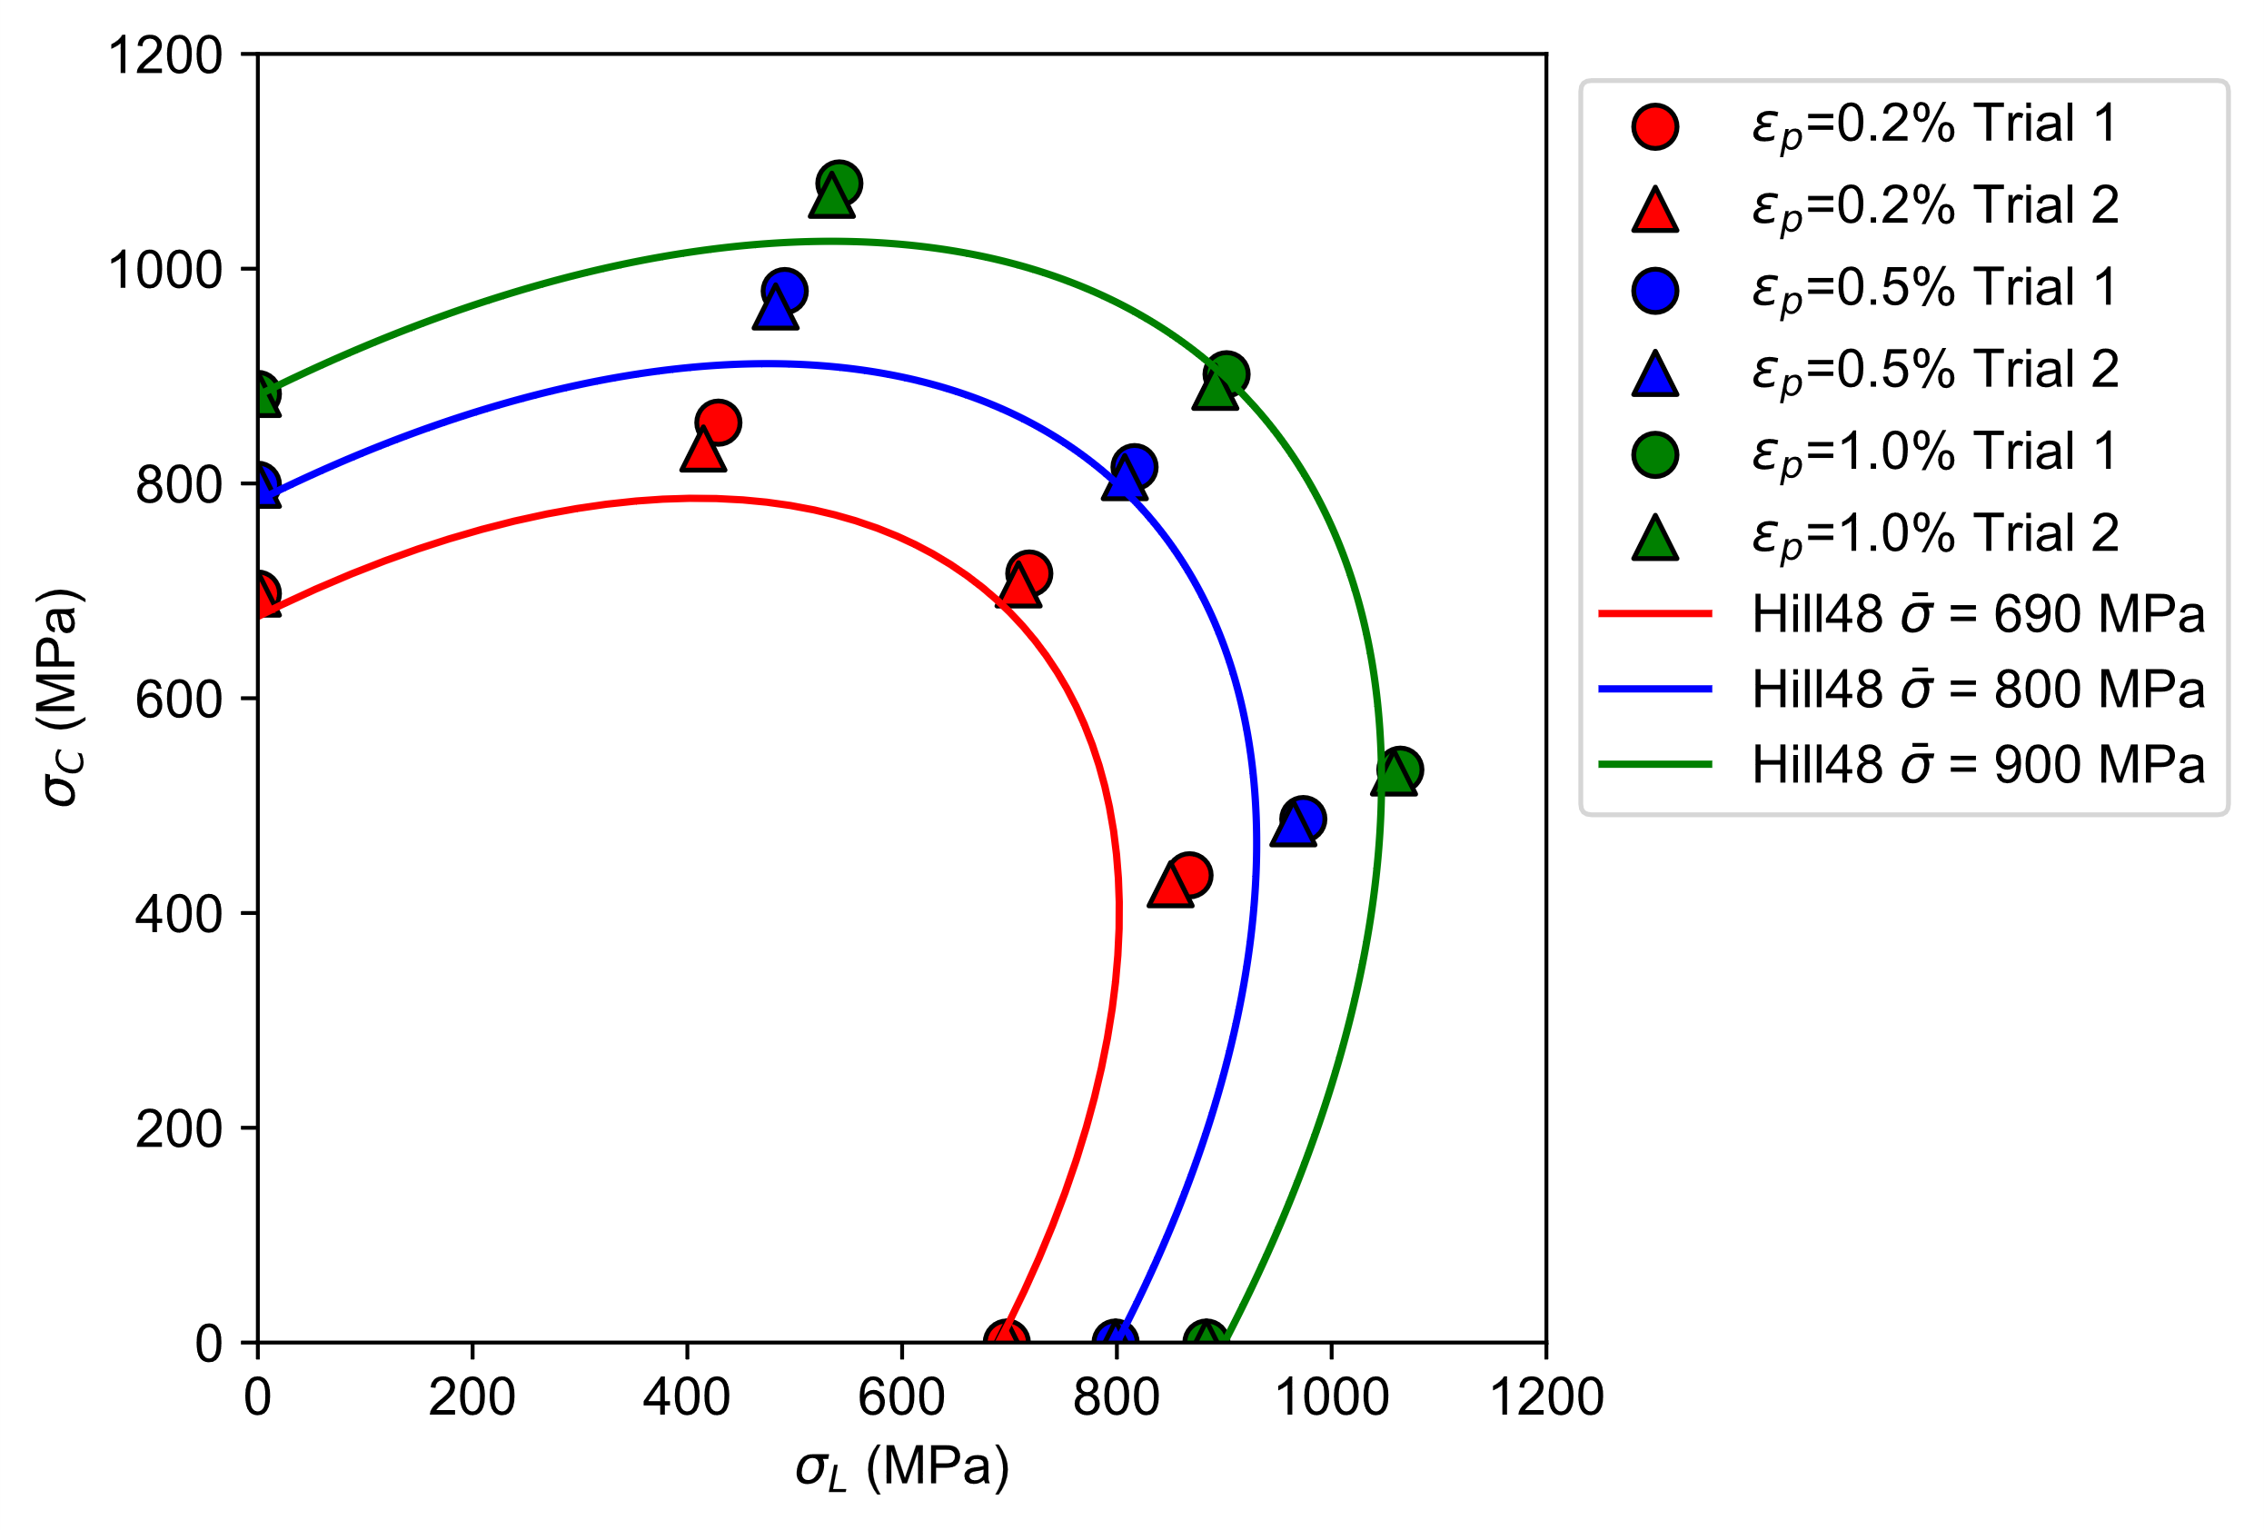
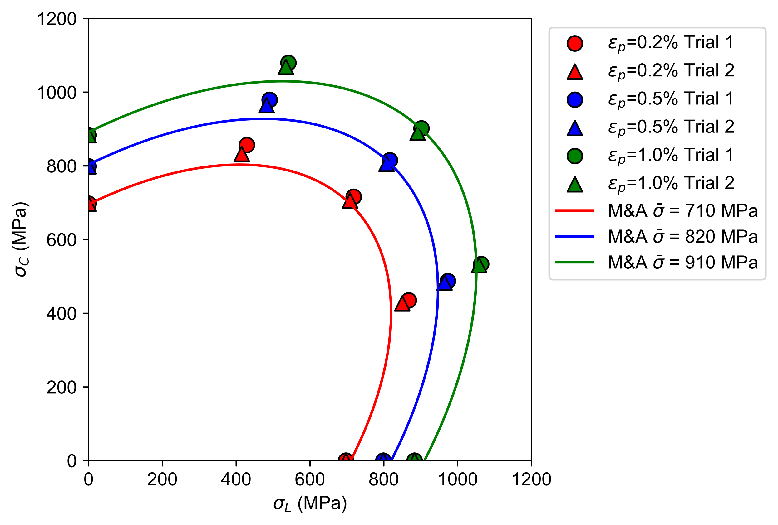
Yield curve fitting using Honda’s uniaxial and TUAT’s biaxial tensile tests (1)
Firstly, each yield curve was fitted independently for each plastic strain level (no constraints)
Isotropic hardening was assumed, so yield function parameters do not change with ${\overline{ε}}_{p}$.
Rx = 1.0
Ry = 0.98
Rxy = 1.0
Rz = 1.0
Hill48
M&A quadratic (m=1)
Independent equivalent stress values
Independent equivalent stress values

Slide 6
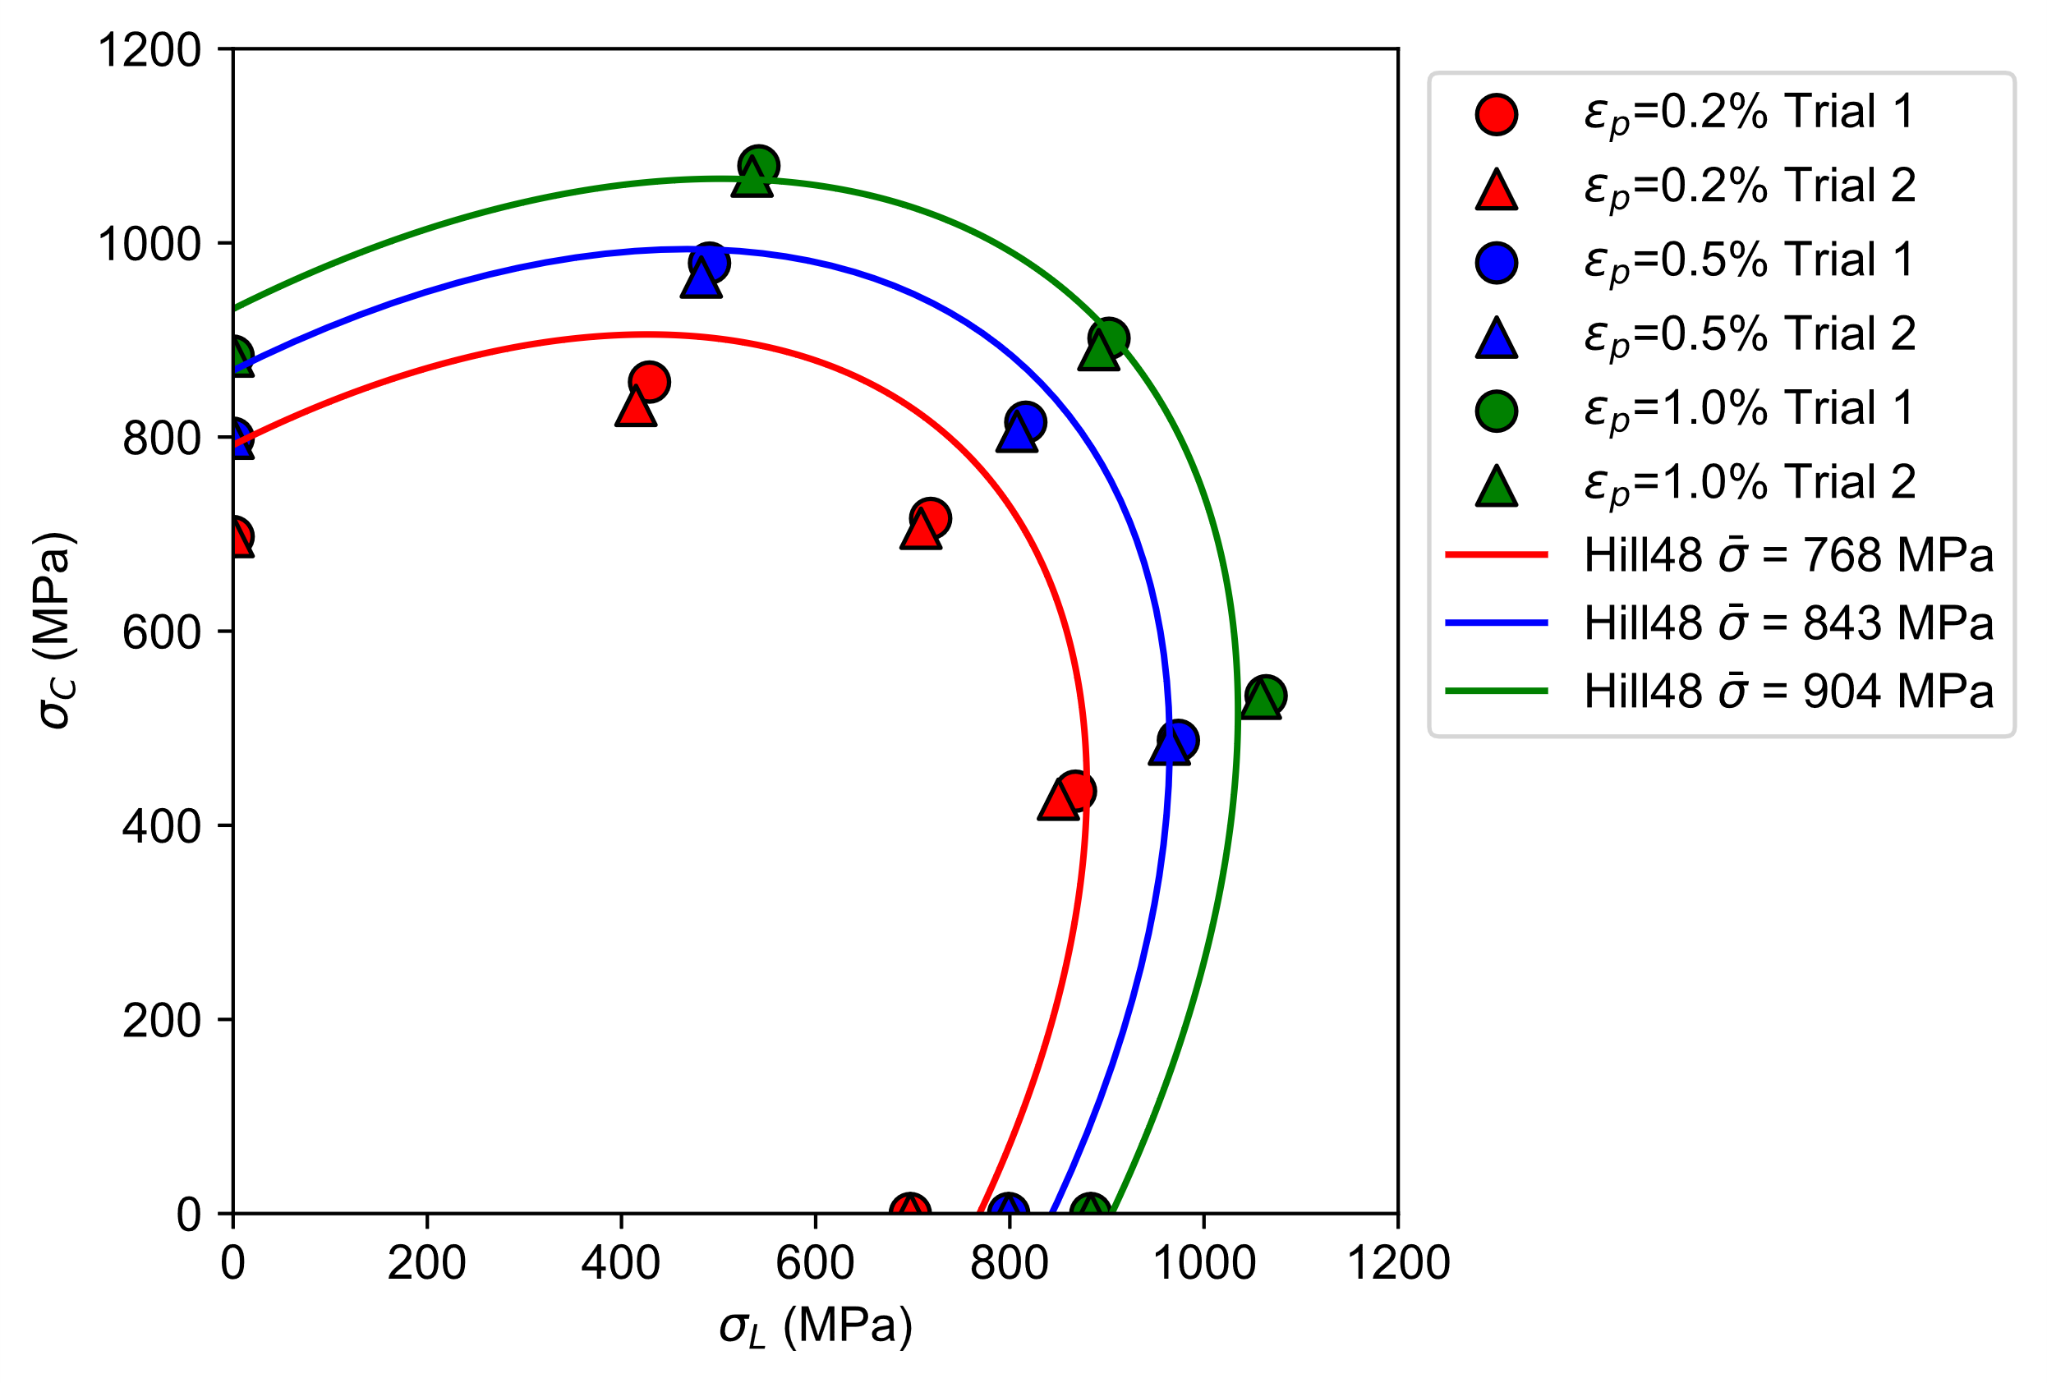

Yield curve fitting using Honda’s uniaxial and TUAT’s biaxial tensile tests (2)
Equivalent stress for the yield curve was calculated from Swift equation of Raw L.
Isotropic hardening was assumed, so yield function parameters do not change with ${\overline{ε}}_{p}$.
Rx = 1.0
Ry = 1.03
Rxy = 1.0
Rz = 1.0
Hill48
M&A quadratic
K | 1447
ep0 | 2.74E-05
n | 0.102
Equivalent stress from Swift equation (Raw L)
Equivalent stress from Swift equation (Raw L)

Slide 7
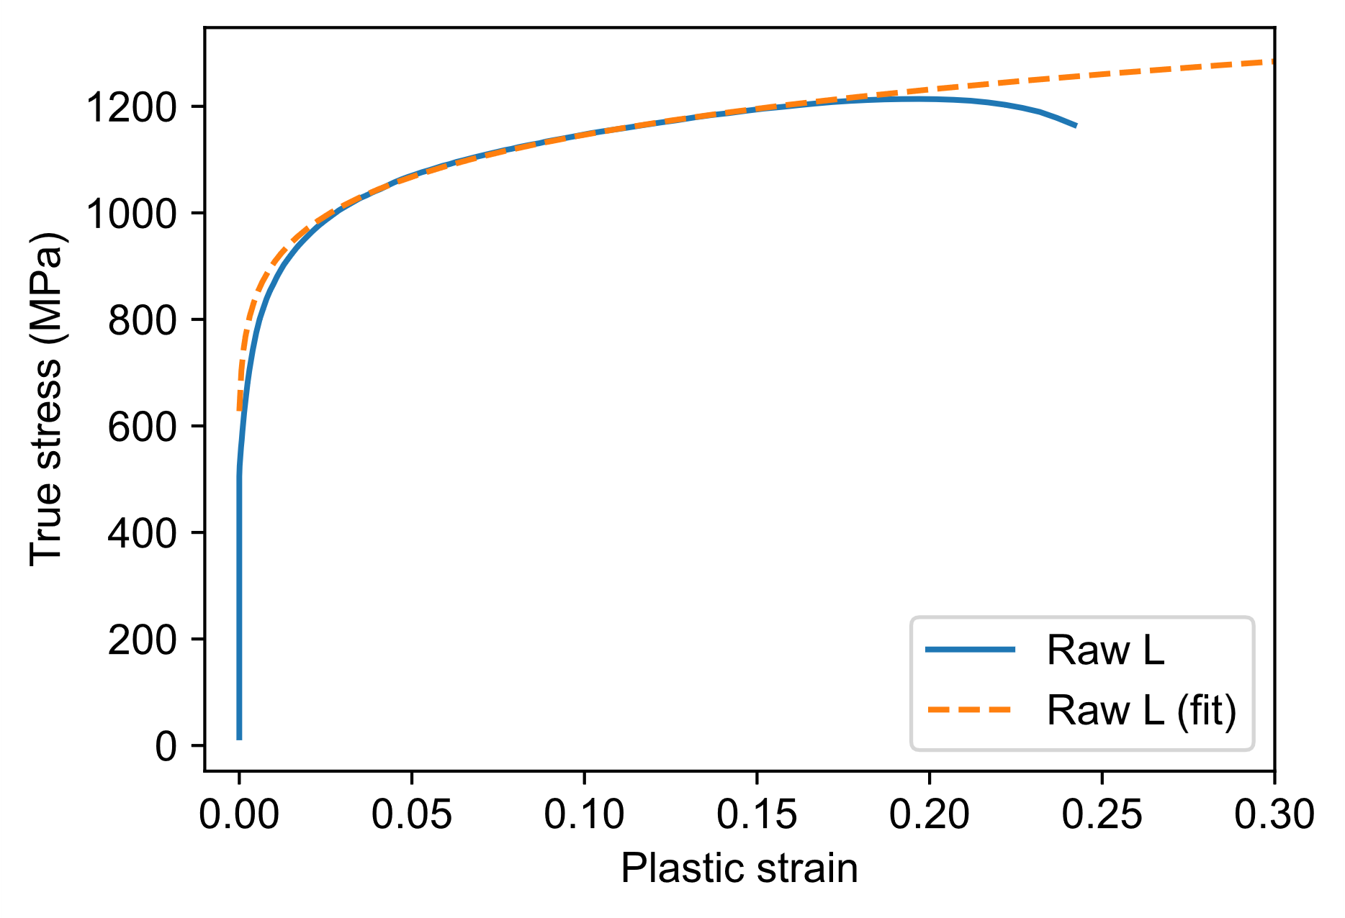
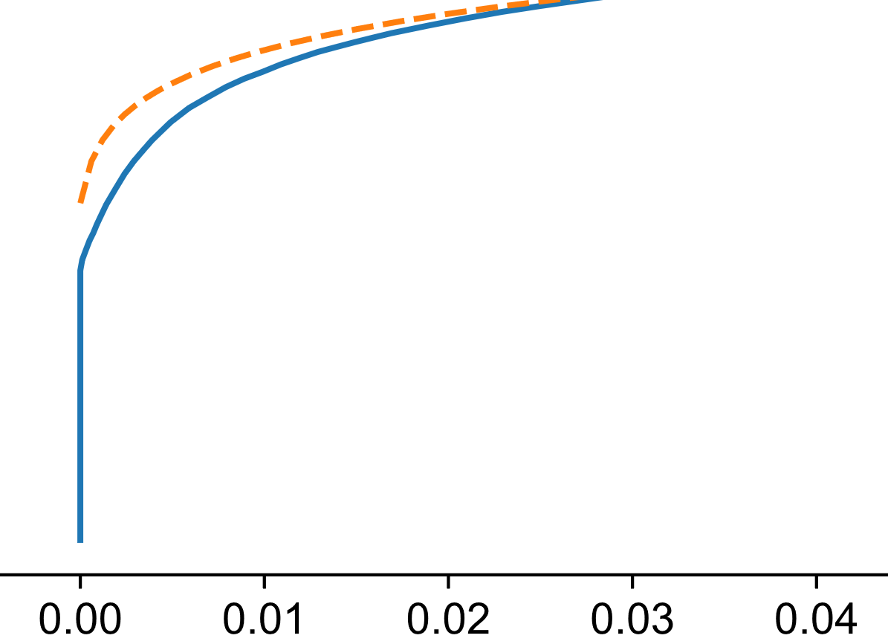
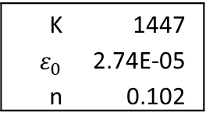
Bad Swift fitting accuracy at small strains
Swift curve fitting accuracy is not good for small strains in this case, which cause wrong reference stress $σ_{0}$
K | 1447
$ε_{0}$ | 2.74E-05
n | 0.102
7

Slide 8
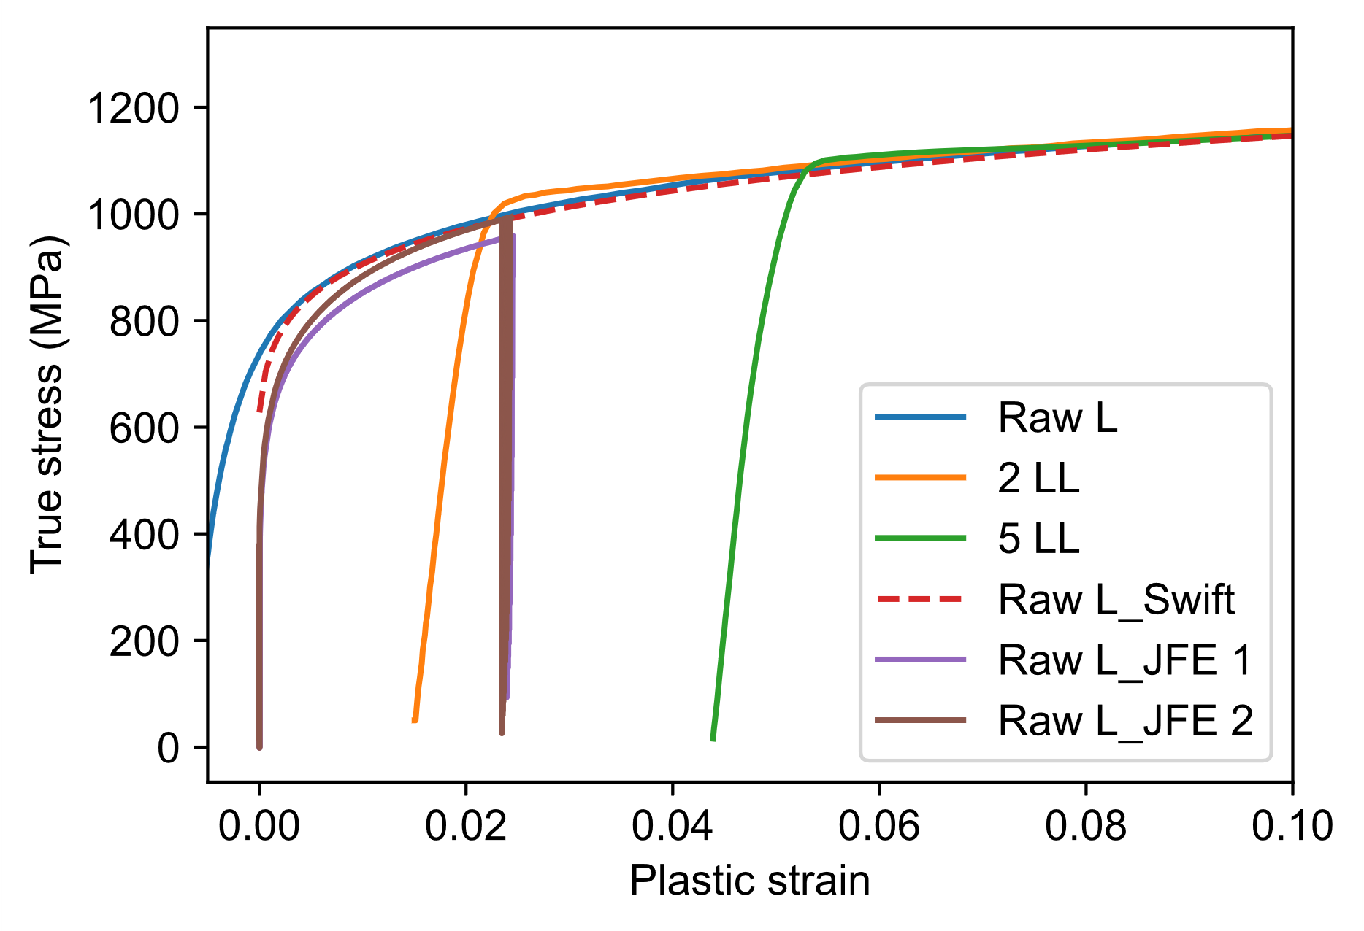
Comparison of Raw L uniaxial SS-curves from Honda with 0.8mm large tensile specimen from JFE
Two representative SS-curves are shown as JFE 1 and JFE 2

Slide 9
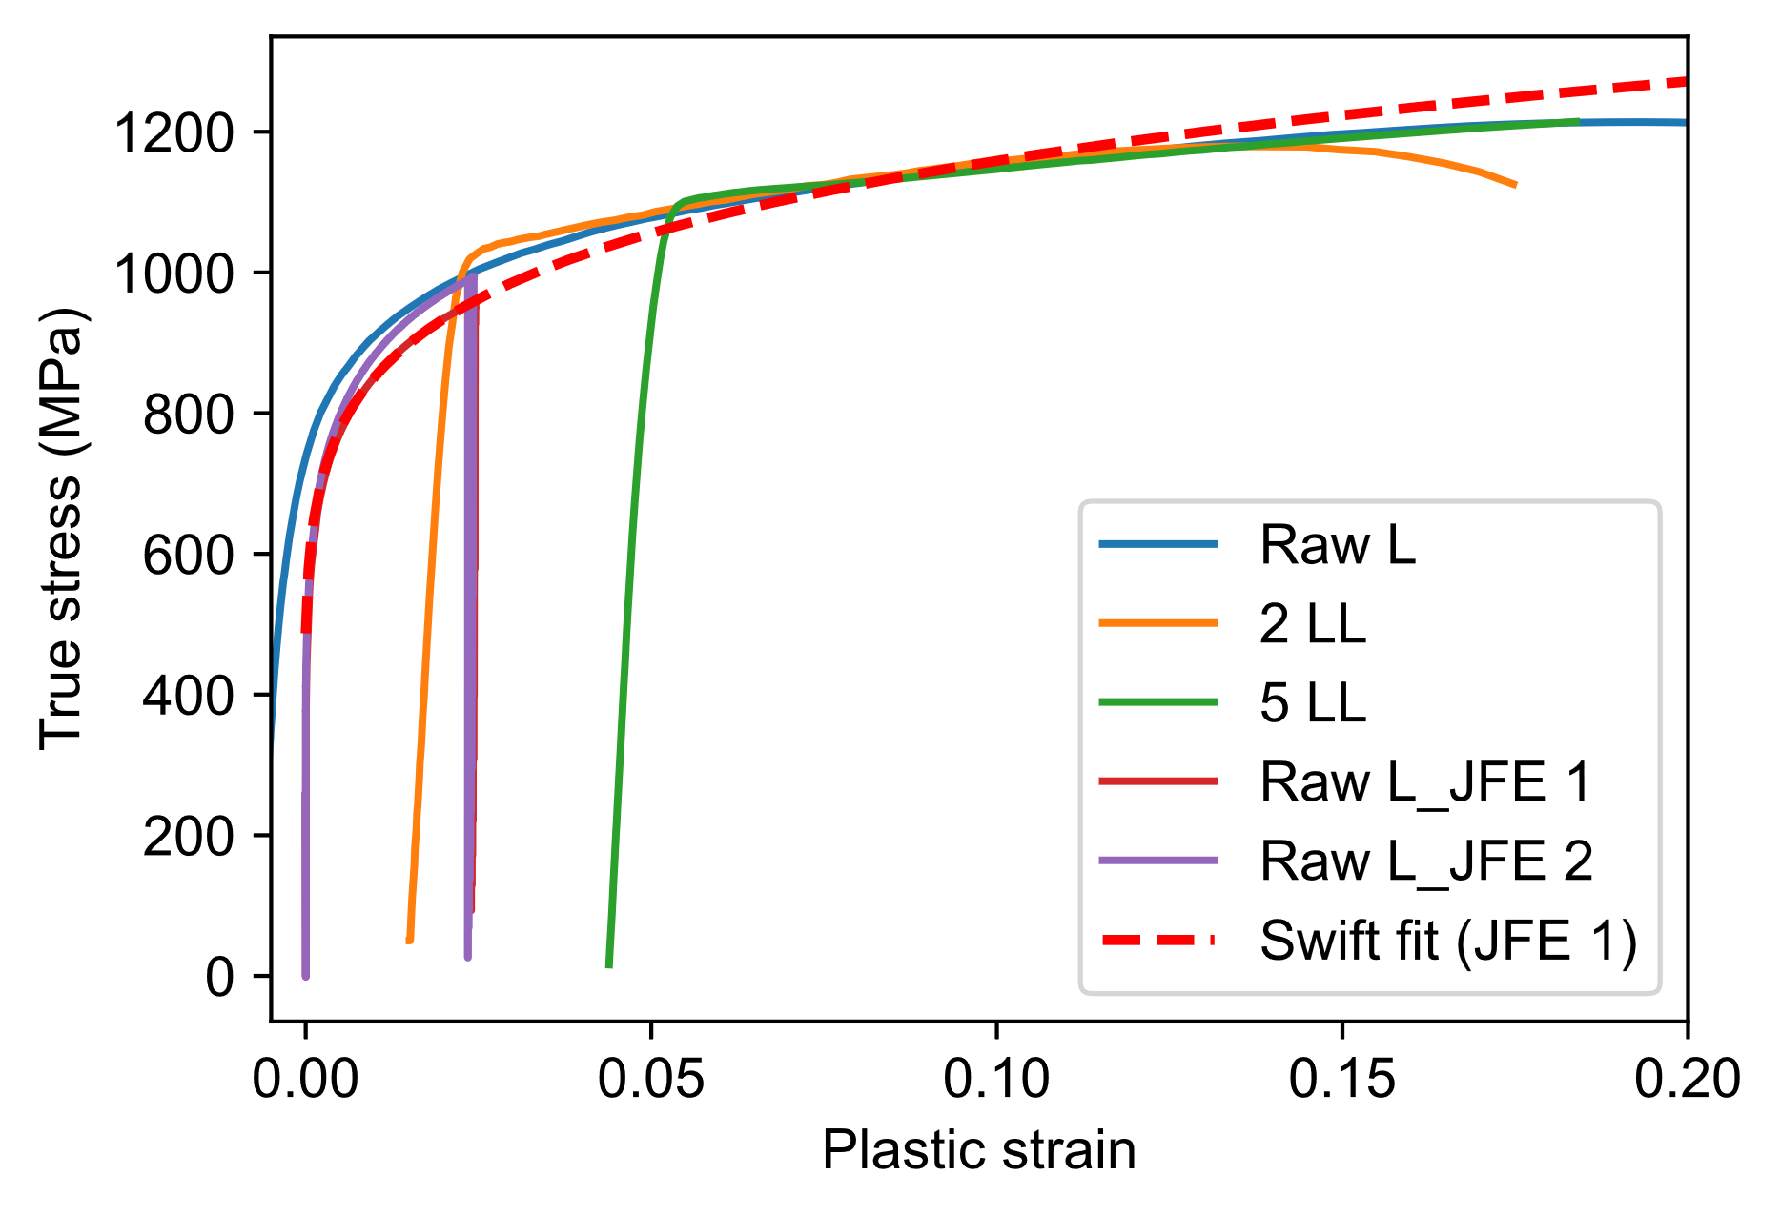
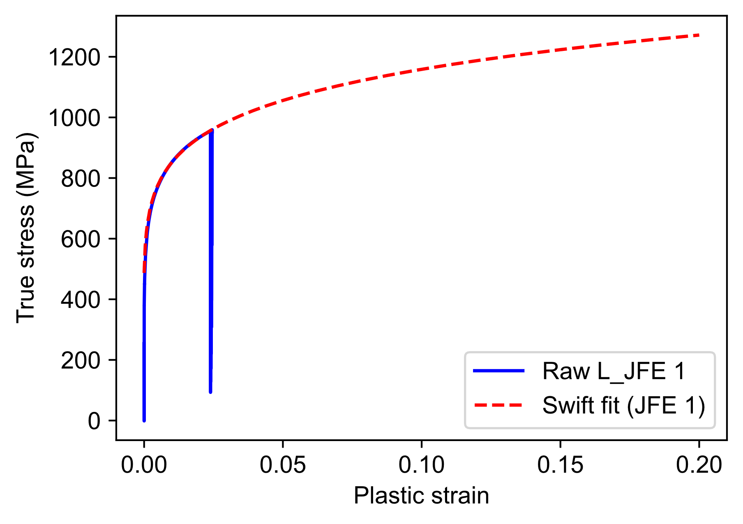
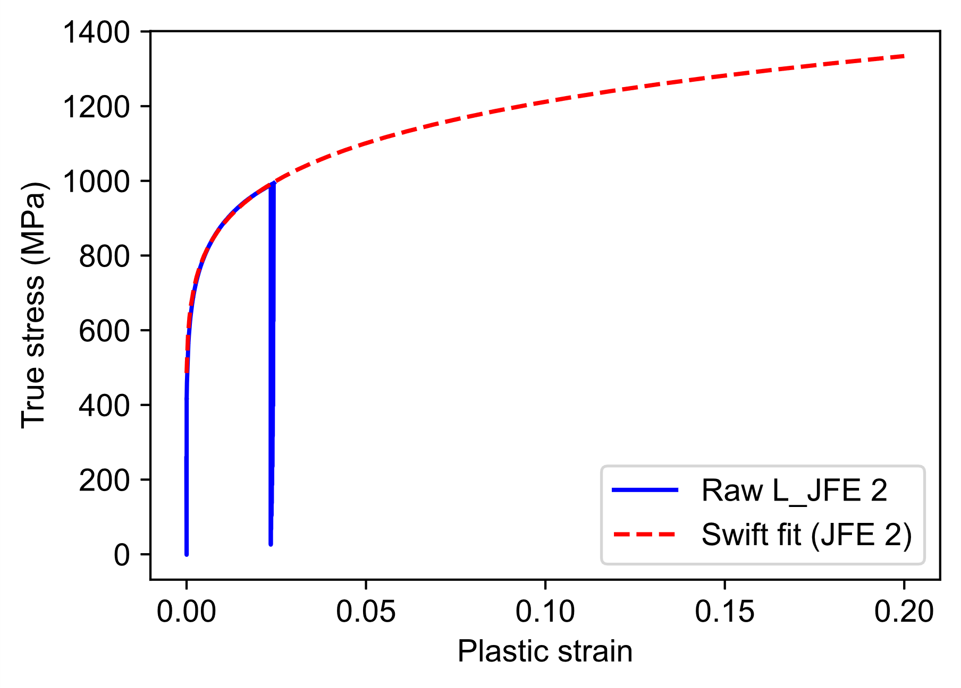
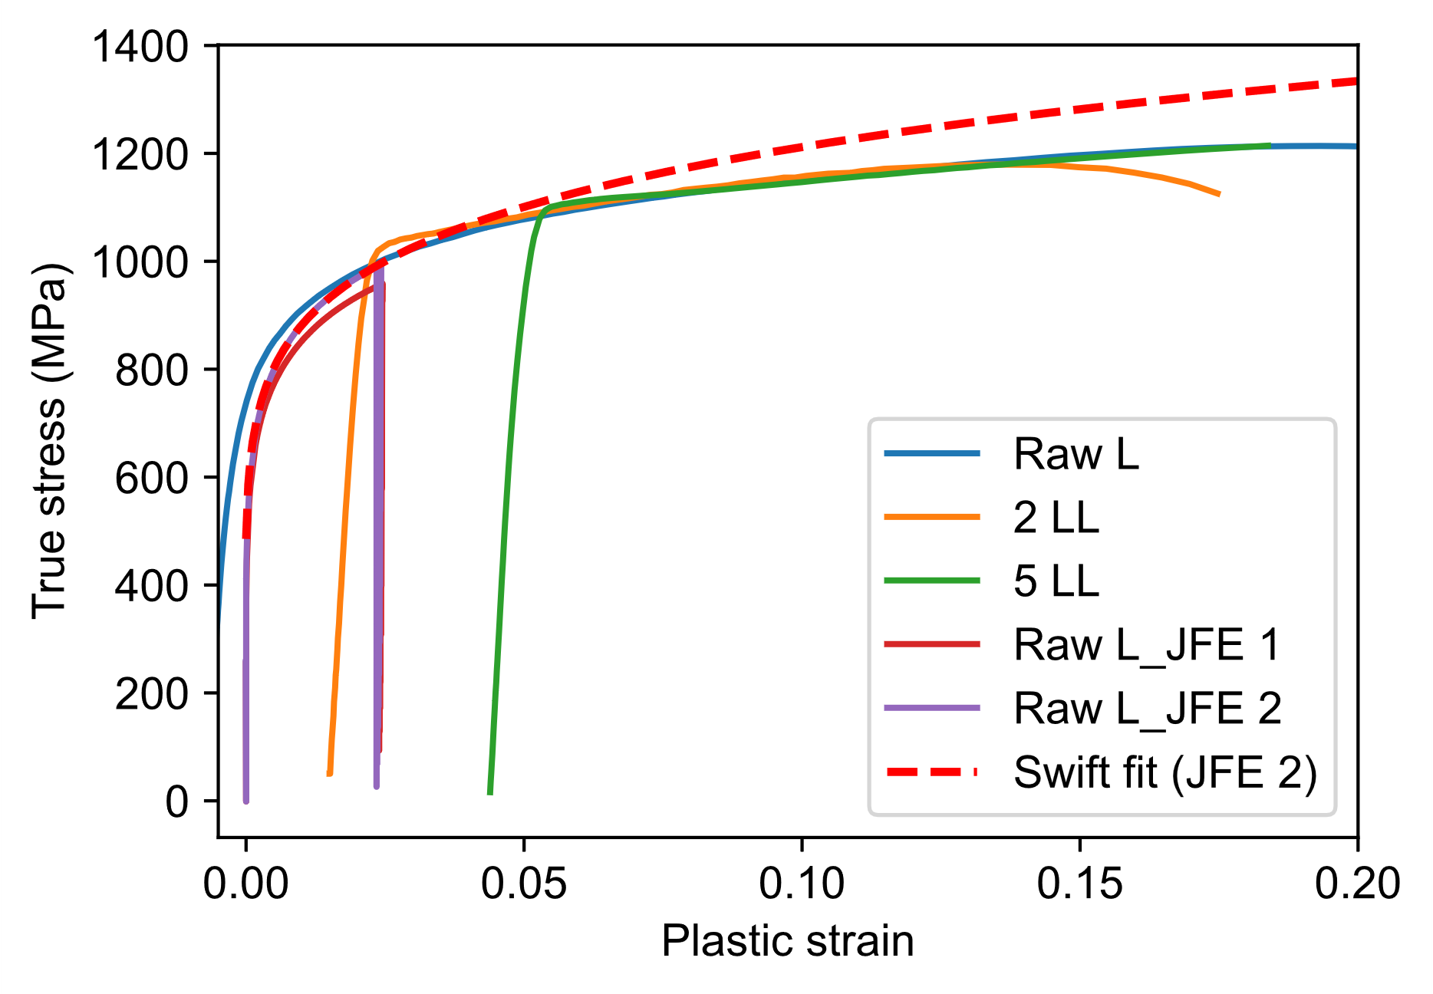
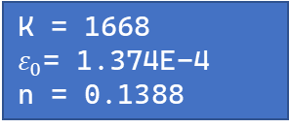
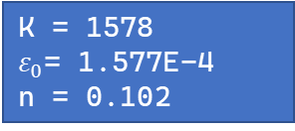
Modification of Swift parameters to fit JFE specimen’s SS-curve
K = 1578
$ε_{0}$= 1.577E-4
n = 0.102
K | 1668
ep0 | 1.374E-04
n | 0.1388
K = 1668
$ε_{0}$= 1.374E-4
n = 0.1388

Slide 10

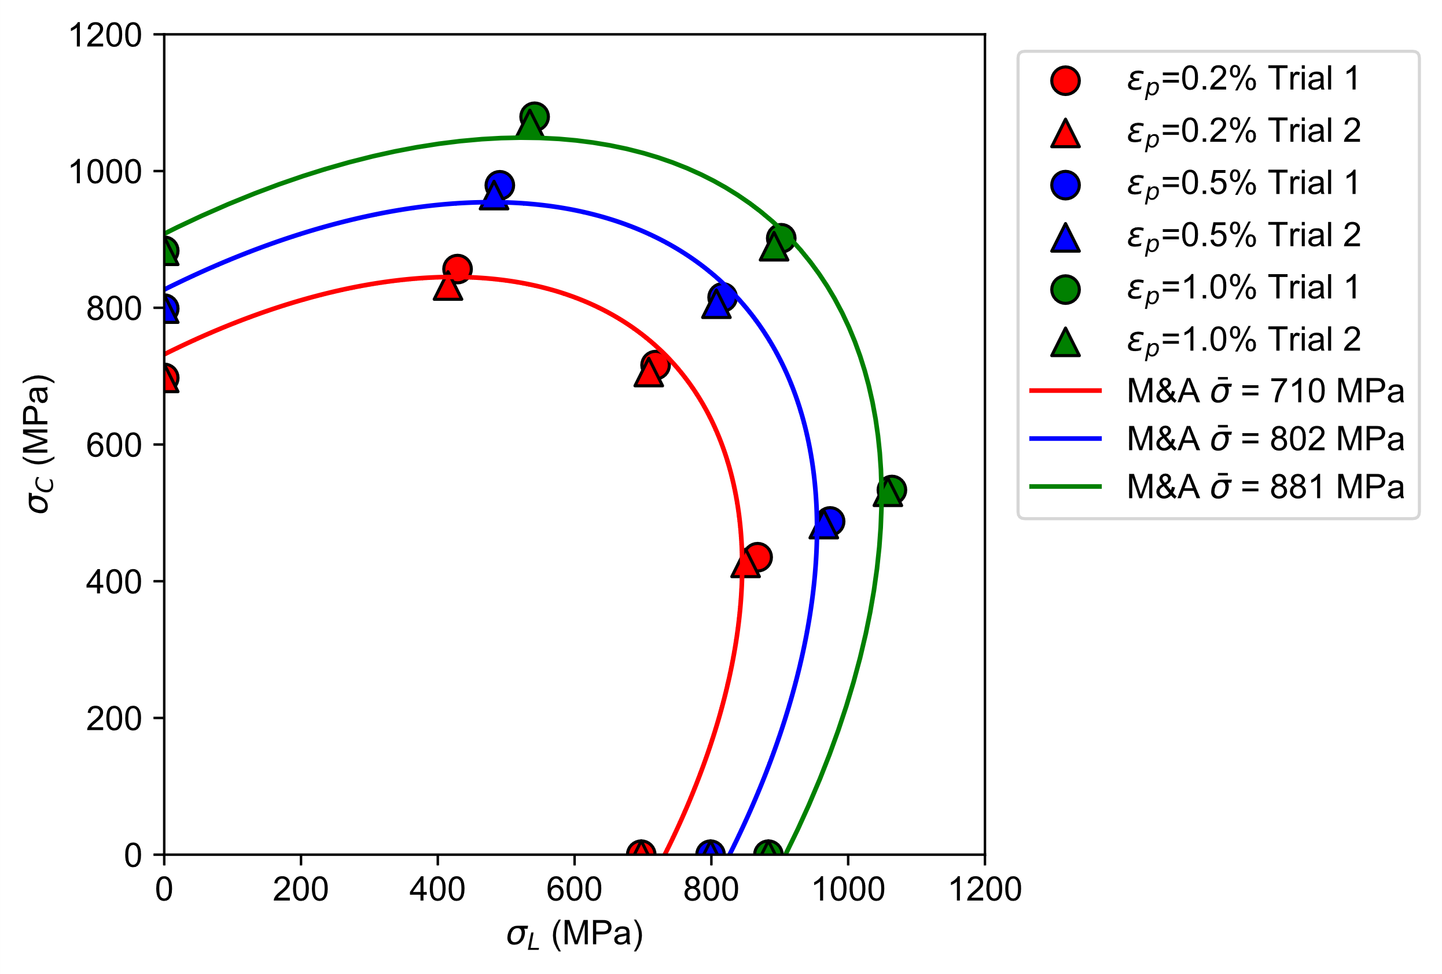

Better fitting accuracy at small strains using optimized Swift parameters (JFE 2)
The optimized fitting parameters by least-squares are the same for both Hill48 and M&A
Rx = 1.0
Ry = 1.029
Rxy = 1.0
Rz = 1.0
Hill48
M&A quadratic
K = 1668
$ε_{0}$= 1.374E-4
n = 0.1388

